Slide 1
Employing and Interpreting Transformers for Music Genre Classification
CSCI2470
Julia Lynn, Michelle Motley, Burke O’Brien

Slide 2
01
02
03
INTRODUCTION
MODEL
RESULTS +
INTERPRETABILITY
Project background and objectives
Model architecture and task-specific preprocessing
Analyze results and interpret the model architecture

Slide 3
Introduction
01
Music genre classification using Transformers

Slide 4
Background:
Problem:
Music Genre Classification is a challenging task for deep learning models
high variability in music: tempo, rhythm, melody can change within a genre
difficult to learn complex relationships between features and genres
Solution:
Transformers are highly effective in Natural Language Processing (NLP) tasks
music is sequential data
transformers can handle large amounts of sequential data and capture the long term dependencies of the music data
Transformers are also more interpretable than other implementations

Slide 5
Objective:
Our model uses a stack of Transformer blocks to learn long-term dependencies in our song representation, and then a MLP stack outputs genre probabilities
A large component of our project is interpretability- we will analyze how our model makes predictions by mapping the Transformer attention, and by using the “XpLique” package (developed at Brown!)
We hope our project will provide greater insight to the challenges and opportunities of music genre classification and shed light upon the interpretability of deep learning audio models

Slide 6


The Dataset
TensorFlow’s GTZAN dataset: consists of 1000, 30-second duration audio files
Each audio file is labelled with one of ten genres:
blues, classical, country, disco, hip-hop, jazz, metal, pop, reggae and pop
Access the dataset through Deeplake library, which provides functionality for loading, visualizing and listening to audio files

Slide 7
Model
02
Model Architecture and Task-Specific Data Representation

Slide 8
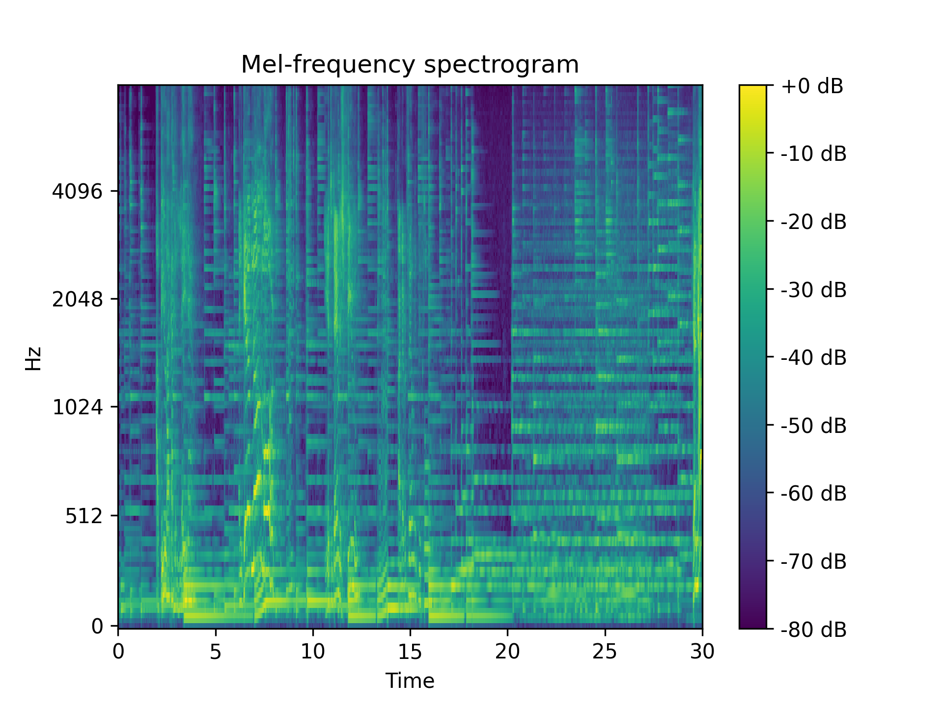
Preprocessing
Data are first reshaped to become two dimensional - amplitude of the audio waveform at a specific point in the song
Librosa package transforms this representation into Mel-frequency spectrograms- standard visual representation of audio data
Spectrograms are pickled for later use
Apply scikit-learn’s train/test split, with 80% of data in the training set
Notes:
Index 994 (train_data[1])

Slide 9
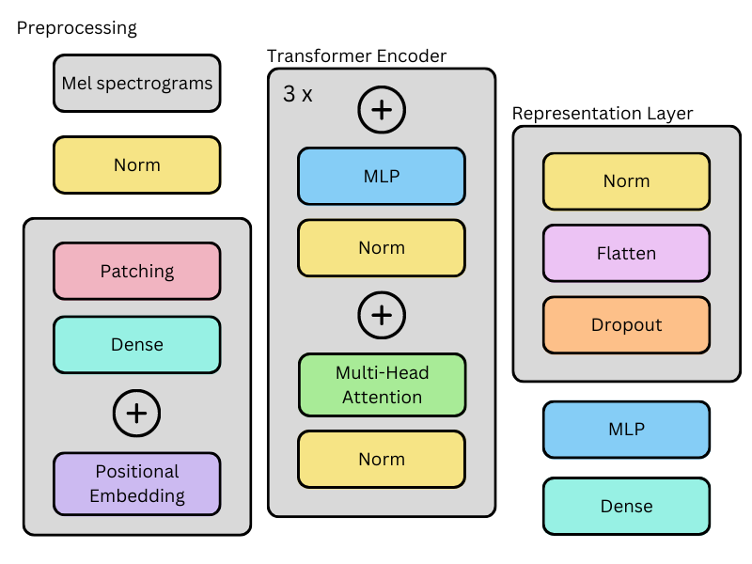
Model Architecture
Adapted from Dosovitskiy et al. (2021)
Notes:
Adapted from a vision transformer architecture
Include diagram of patching?

Slide 10

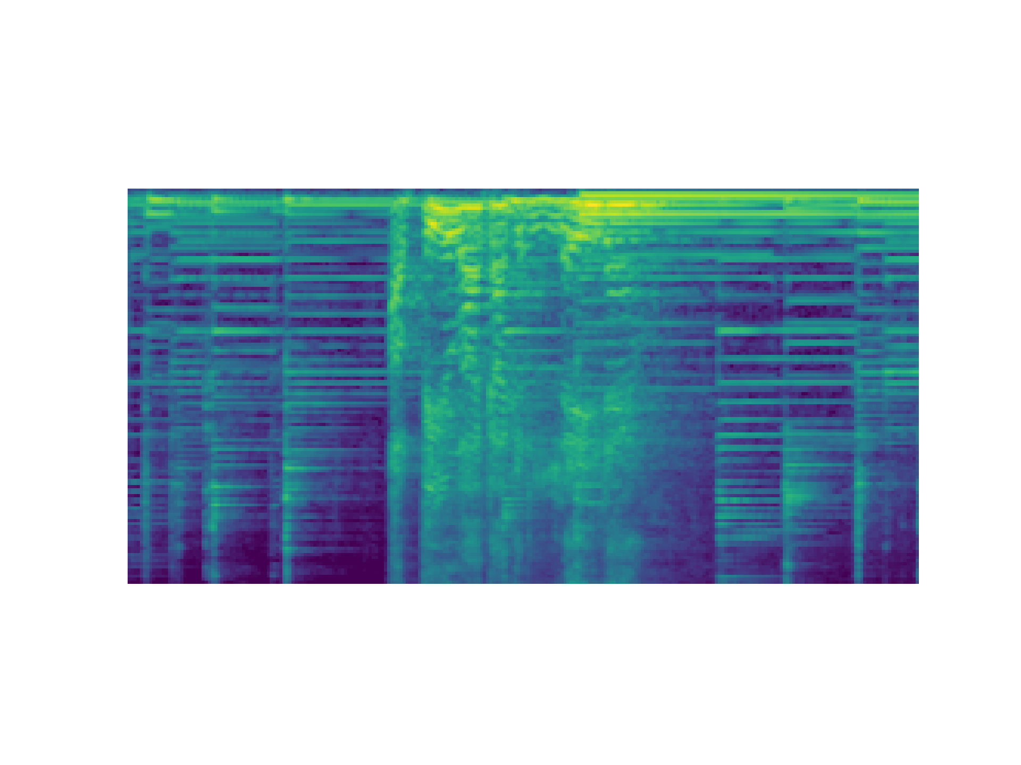
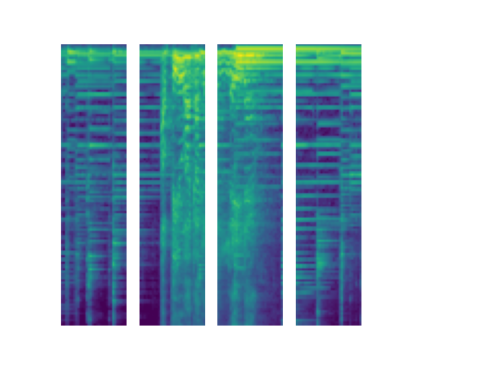
Patching
Notes:
Break songs into sequential “tokens” similar to a language model - 32 patches

Slide 11
Results and Model Interpretations
03

Slide 12
Results
Model Results
Genre Results
Interpretations
Overall model accuracy
Confusion matrix
Where in the sound clip is the model is “focusing” when making predictions

Slide 13
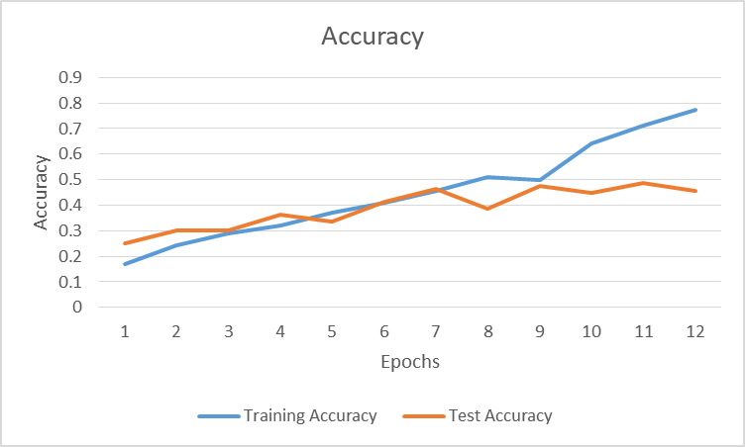
Model Results:
Test Accuracy: 52.5%
(Compared to 65% on a similar model using CNN)
Evidence of overfitting
Notes:
Dropout
Masking
Larger data set

Slide 14
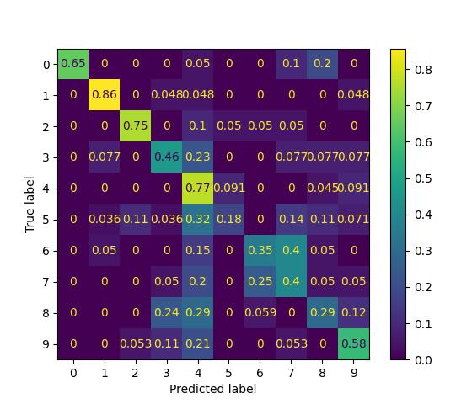
By Genre Results
High variation in performance across genres:
0 - Pop
1 - Metal
2 - Classical
3 - Rock
4 - Blues
5 - Jazz
6 - Hip Hop
7 - Reggae
8 - Disco
9 - Country
Highest accuracies: Metal (86%) Blues (77%) Classical (75%) | Lowest accuracies: Jazz (18%) Disco (29%) Hip Hop (35%)
Notes:
Each genre evenly represented in the data set
Heavily over-predicting blues

Slide 15
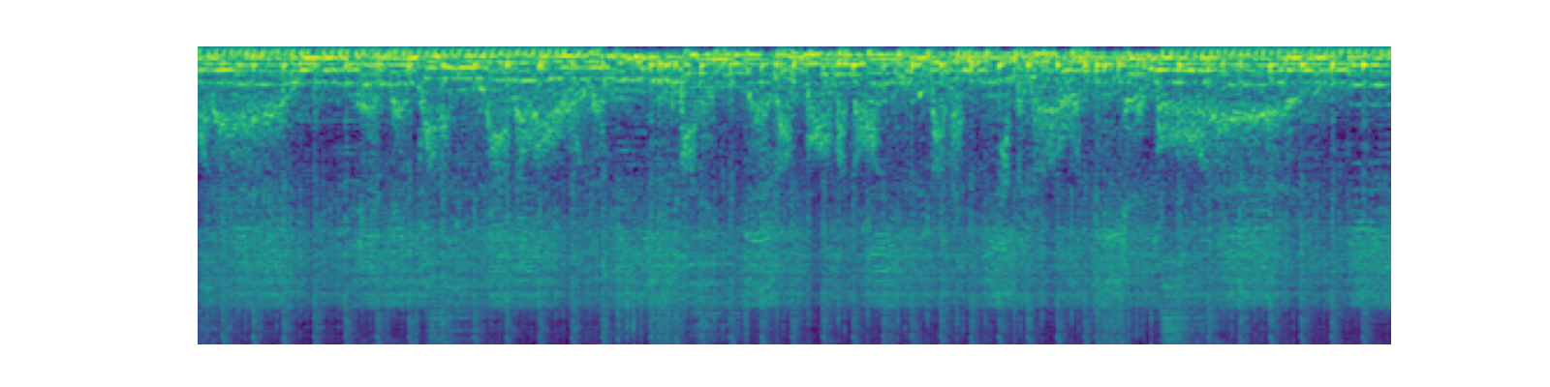
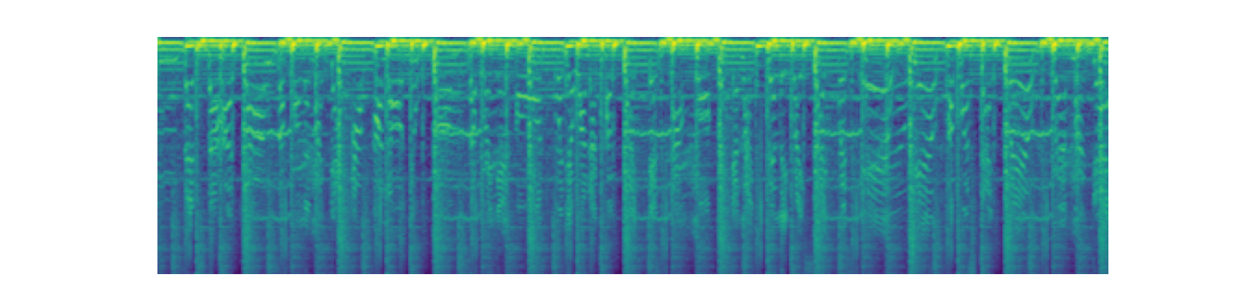
Metal song vs jazz song
Notes:
Idx 15 and idx 28

Slide 16
Xplique
Open-source python package developed by Brown’s Thomas Fel
Thank you to Thomas for introducing this package at DSCoV!
Implements many different feature attribution, feature importance, and model concept methods
Easy to use! Great tutorials!

Slide 17
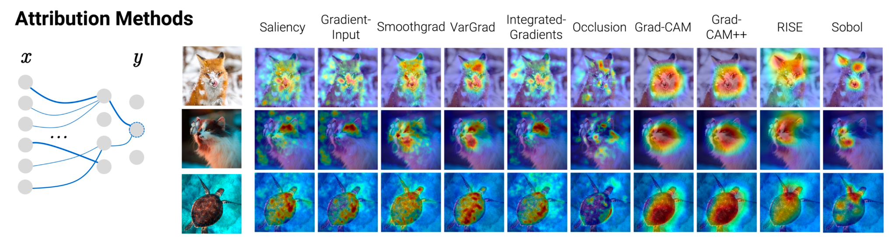
Xplique Capabilities
Xplique Capabilities
Source: Xplique Github

Slide 18
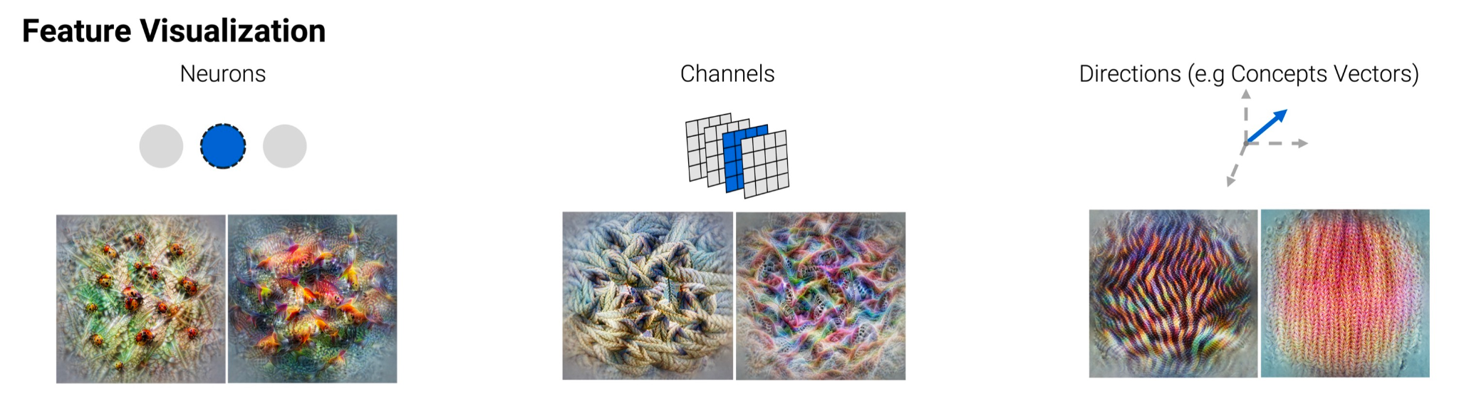
Xplique Capabilities
Xplique Capabilities
Source: Xplique Github

Slide 19

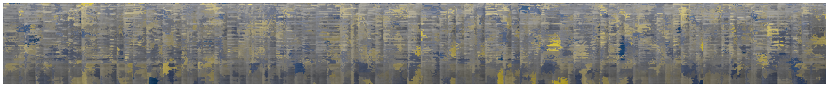
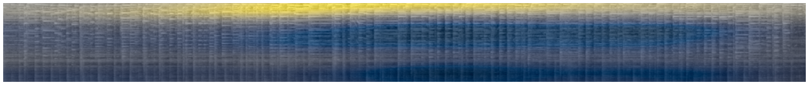
Using Xplique:
We tried a number of different attribution methods on our model
Some were…. not great
Kernel Shap attribution map
Others were a little more informative
RISE attribution map

Slide 20
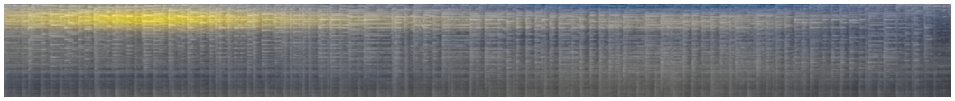
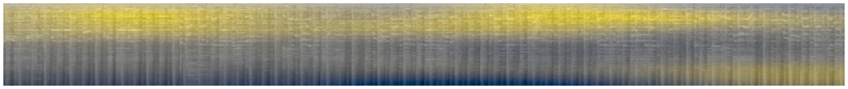
Example misclassified songs
30-second clip of “Jeepers, Creepers” by Lester Young- jazz song misclassified as rock
30-second clip of “Midnight Rambler” by The Rolling Stones- rock song misclassified as blues
Let’s listen!
Notes:
Do we know what the top part of the spectrogram corresponds to?

Slide 21
Attention Maps
Another way to visualize where in the input data the model is focusing when making predictions
We pass a test song through the model, and extract the average attention values for each patch from our three Transformer blocks
We’re hoping that like the Xplique attribution methods, comparisons of attention maps can help us better understand the learned “genre subspace” in audio data

Slide 22
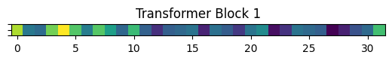
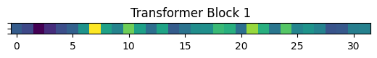
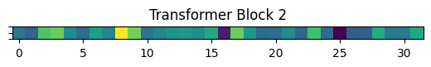
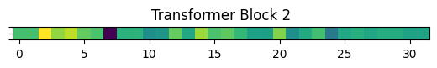
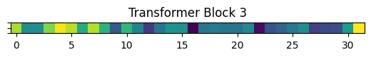
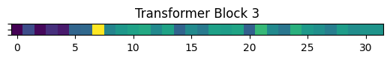
Attention Maps:
Jeepers Creepers
Midnight Rambler
Each block assigns similar values to the same sections of the song
Roughly match the RISE maps
These are more difficult to interpret…

Slide 23
Conclusion
Problem
Preprocessing
Model
Model not as good as we were hoping…
Model is much better on certain genres
Interpretability study sheds light on dataset, model
Automatic Genre classification
Spectrograms with patching
Modified Vision Transformer
52.5% accuracy fell short of our goal of 65%
Performs much better on metal and classical than jazz
Model is focusing on lower frequencies, some genres are more similar than others
Notes:
Areas for further investigation!!
Not best data representation for this problem

Slide 24
THANKS!
Any questions?
Contact
burke_obrien@brown.edu
julia_lynn@brown.edu
michelle_motley@brown.edu

